Slide 1

Registered Entity Align Training
Align/SEL Refresher and IRA/Entity Questionnaire
July 2024

Slide 2
Antitrust Compliance Guidelines
It is the policy of ReliabilityFirst to obey the antitrust laws and to avoid all conduct that unreasonably restrains competition. It is the responsibility of every ReliabilityFirst participant to adhere to ReliabilityFirst’s Antitrust Compliance Guidelines, a copy of which is available on ReliabilityFirst’s website. If there are any questions, please contact me.

Slide 3
Training Agenda
Review Align and ERO Secure Evidence Locker (SEL)
Align Access and Roles
  ERO Portal Account Access
  Align USER Access
  Align Permission Roles
ERO SEL Functionality
NERC Help Desk Tickets
Align IRA Process
  RFQ/ERPQ
Training Resources

Slide 4
Review Align and ERO Secure Evidence Locker (SEL)

Slide 5
What is Align
Align is a system which moves all ERO compliance monitoring and enforcement business processes to a common standardized platform, resulting in a consistent application of the ERO Enterprise CMEP and a more secure method of managing and storing CMEP evidence and data
The objectives and benefits of the Align Project are:
  Single, common portal for registered entities, enabling consistency of experience
  Real-time access to information, eliminating delays and manual communications
  Improved capability to support the Risk-Based Compliance Oversight Framework
  Enhanced quality assurance and oversight, enabling consistent application of the CMEP
  Improved analytics, including visibility into compliance and reliability risks
  Increased capability to implement audit best practices and processes (planning, fieldwork, reporting, quality assurance)
  Standardization and implementation of common business processes and workflows, enabling increased productivity

Slide 6
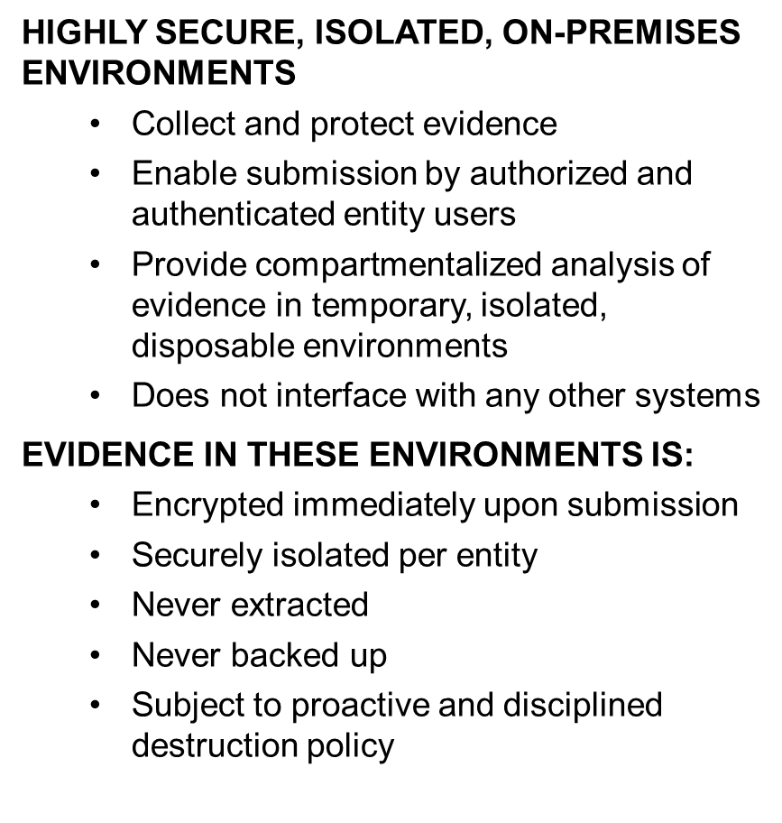
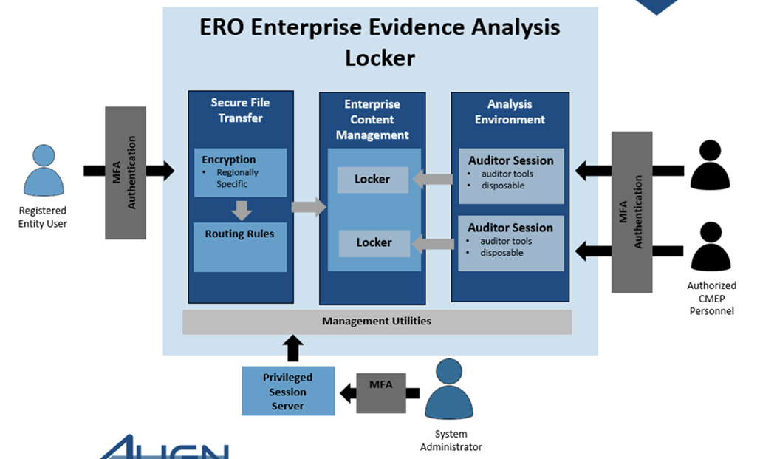
What is the ERO Secure Evidence Locker (SEL)

Slide 7
Align Access and Roles

Slide 8
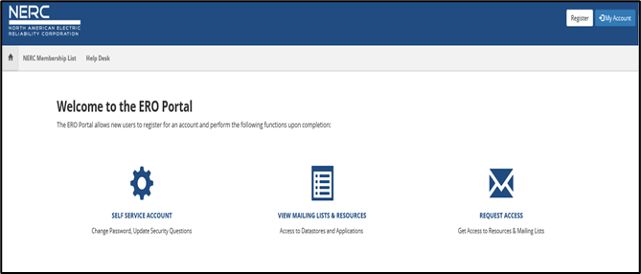
ERO Portal Access
All users MUST have an ERO Portal Account
(Registered Entities User Access Guide)
Set-up ERO Portal Account:
    Navigate to https://eroportal.nerc.net
    Select “Register” in upper right-hand corner
    Complete the registration form and click “Submit”
  Verify ERO Portal Account:
    Navigate to https://eroportal.nerc.net
    Select “Sign In” in the upper left hand corner
    Enter your credentials to confirm access to ERO Portal

Slide 9
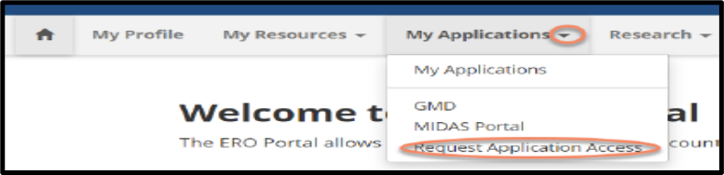
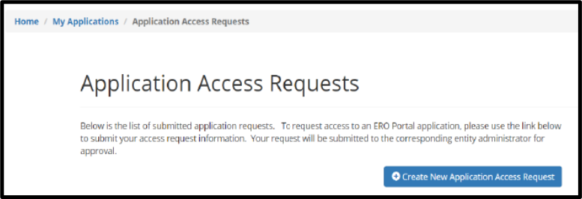
Access to Align
Access to Align
  All Align users MUST have an ERO Portal Account
    ERO Portal Registration (pgs. 4-8,15-18)
    Multi-Factor Authentication set-up is required for ERO Portal Account
    (pgs. 9-14)
    ERO Portal login process (pgs. 19-24)
    Requesting access to Align (pgs. 25-31)
    Approving access Requests (pgs. 32-34)
Reference – Registered Entity User Access Guide

Slide 10
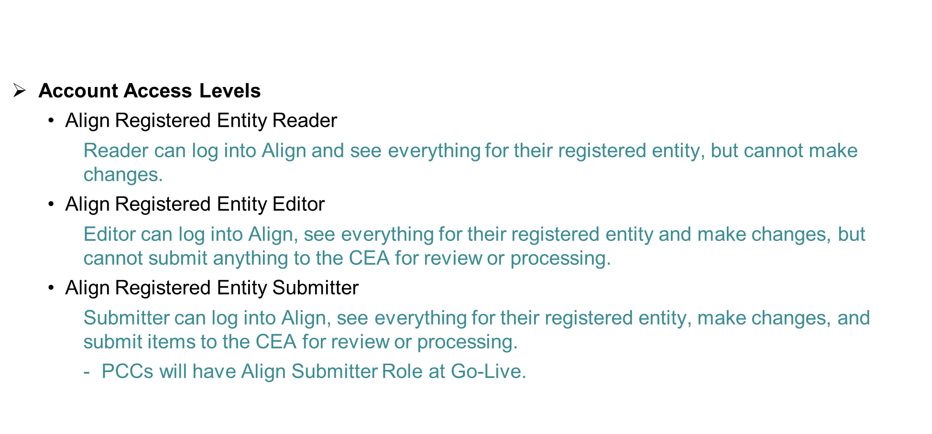
Align Account Access Roles

Slide 11
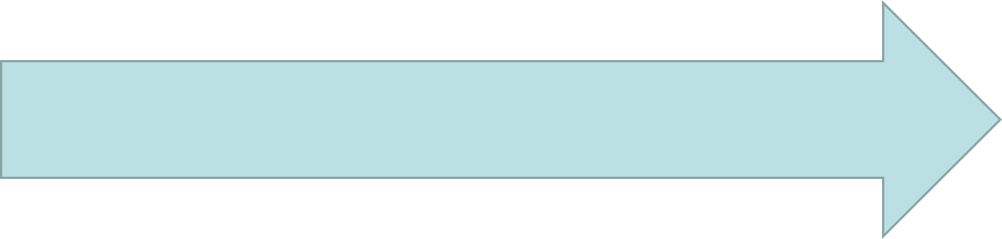
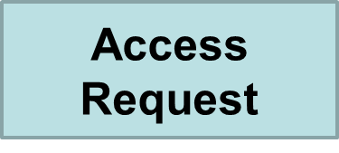
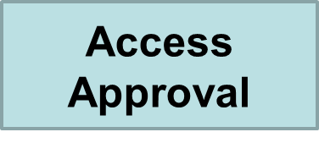
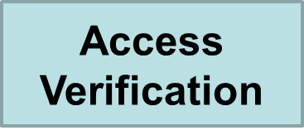
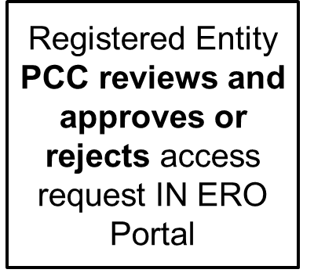
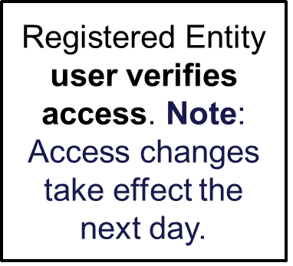
Align Account Access
Registered Entity user requests access level to Align
NOTE; Submitter Access changes may take up to 24 hours to be effective

Slide 12
ERO SEL Functionality

Slide 13
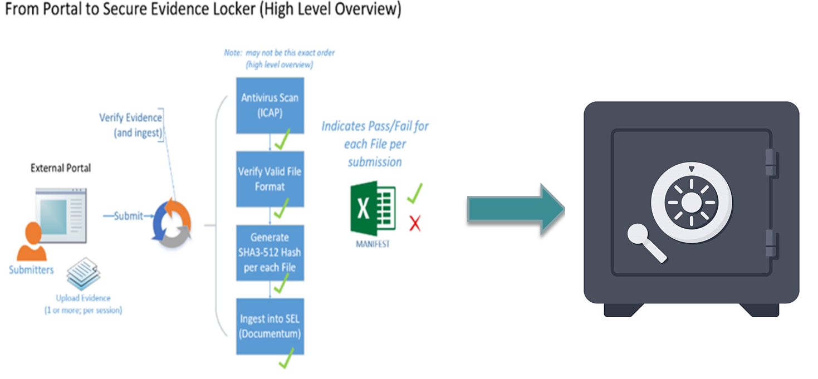
ERO Secure Evidence Locker Portal

Slide 14
ERO Secure Evidence Locker Access
Google Chrome or Microsoft Edge are the preferred browsers. Internet Explorer is NOT supported!

Slide 15
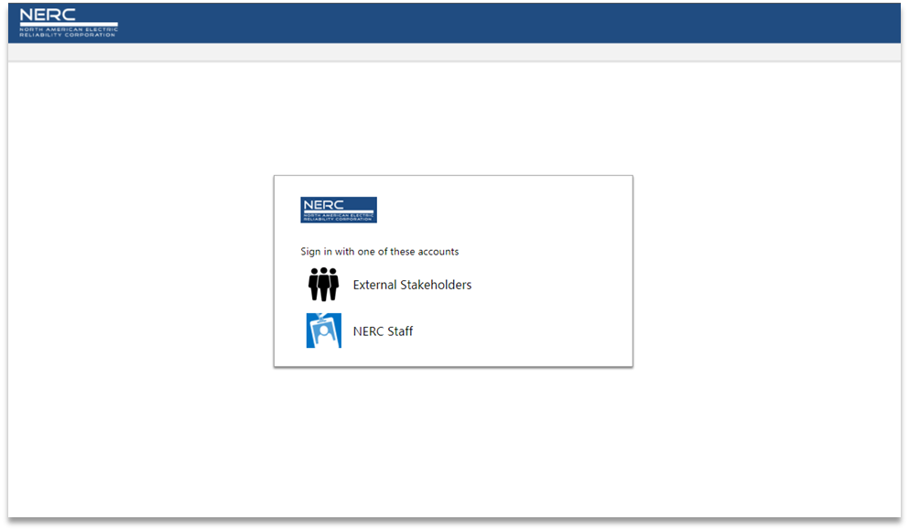
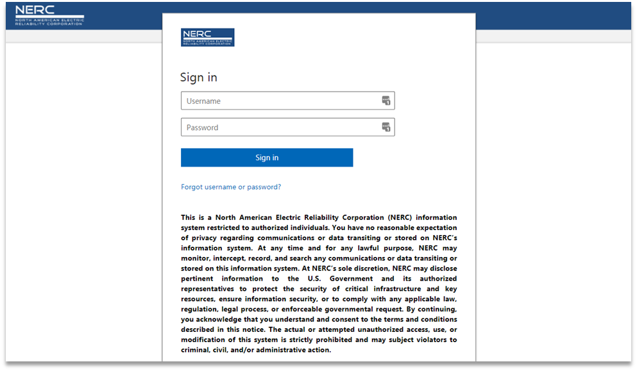
ERO Secure Evidence Locker Walkthrough
SEL Submission Portal: https://eus.eroenterprise.com/nerc-infrastructure/

Slide 16
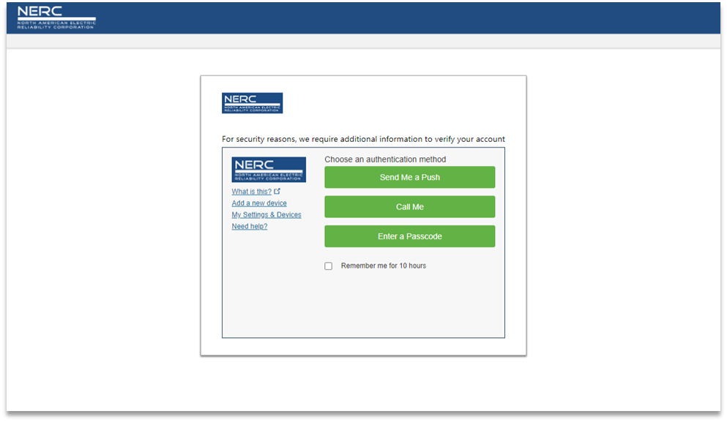
ERO Secure Evidence Locker Walkthrough

Slide 17
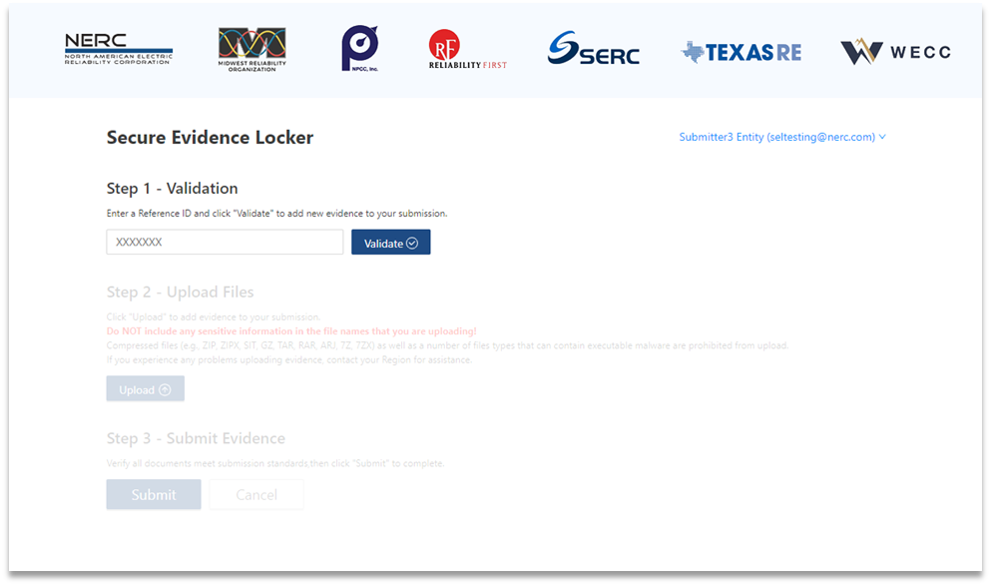
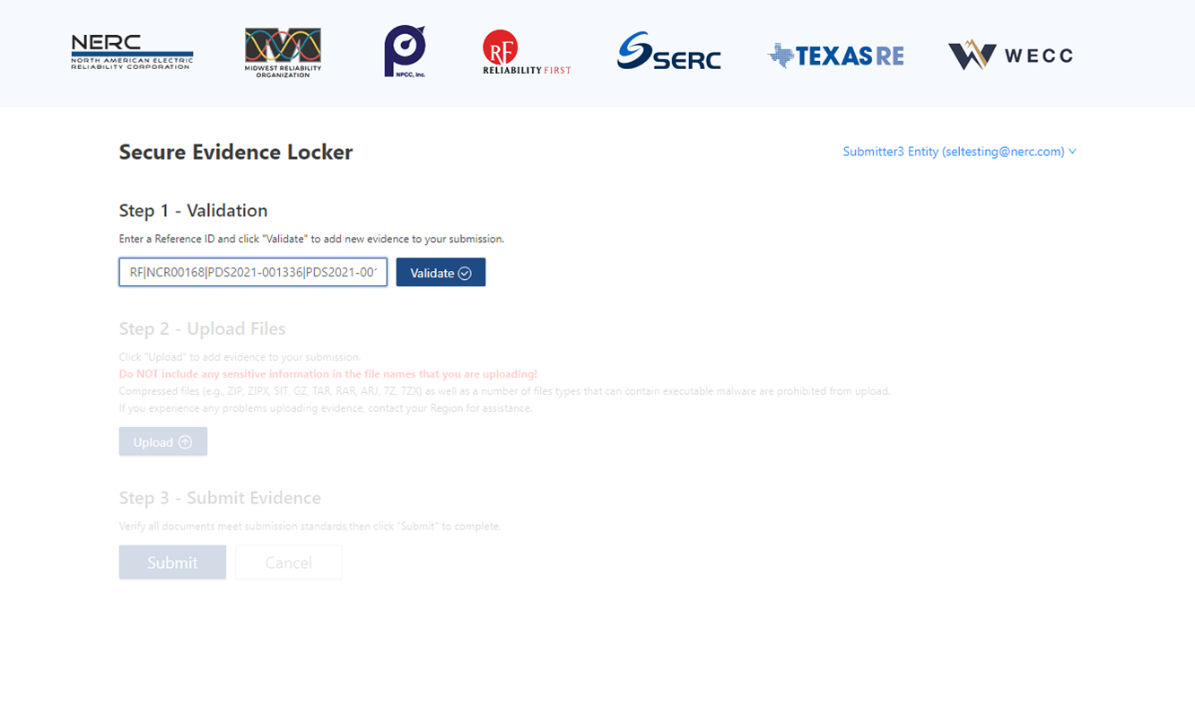

ERO Secure Evidence Locker Walkthrough

Slide 18
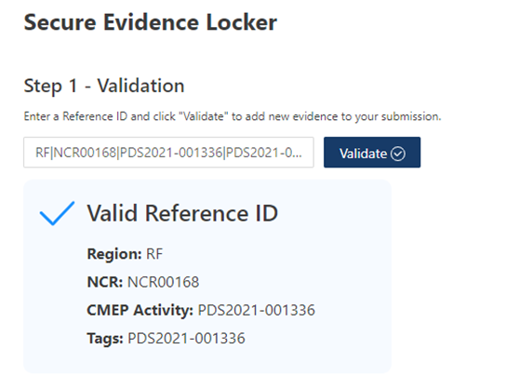

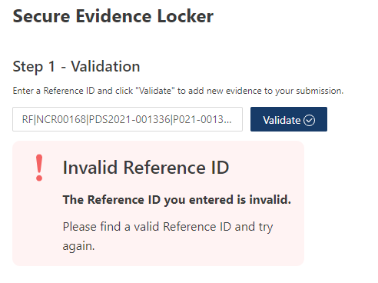

ERO Secure Evidence Locker Walkthrough

Slide 19
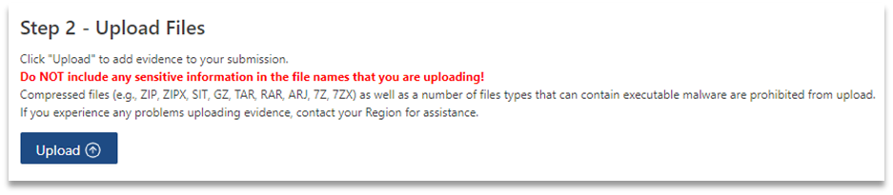
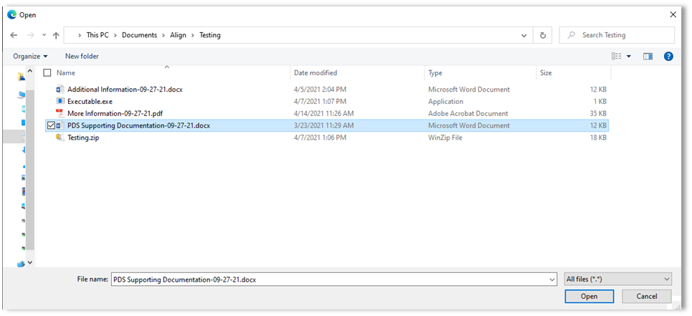
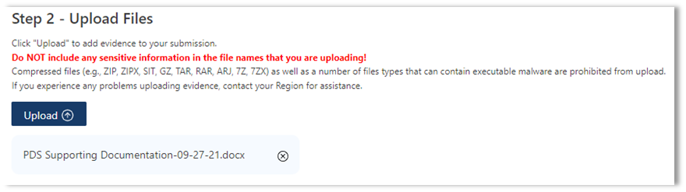

ERO Secure Evidence Locker Walkthrough
Upload a single file

Slide 20
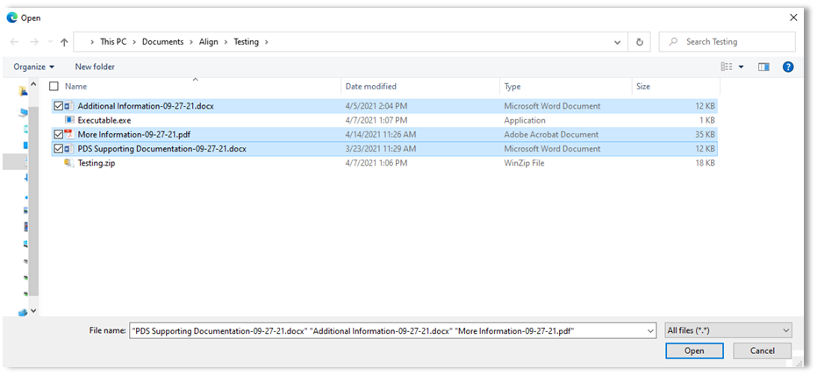
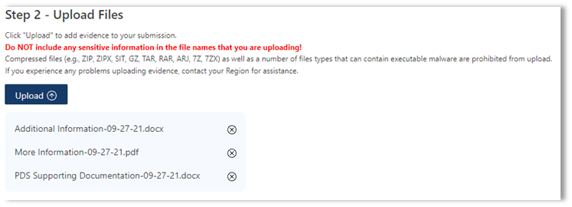
ERO Secure Evidence Locker Walkthrough
Upload multiple files

Slide 21
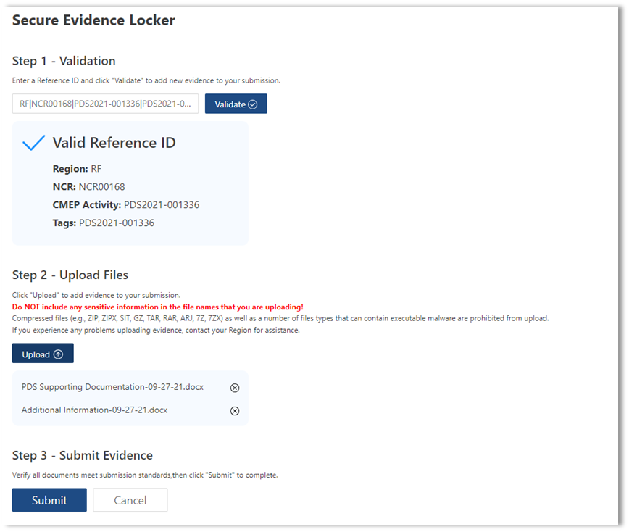
ERO Secure Evidence Locker Walkthrough
The SEL is available Monday through Friday from 0800-2300 ET. Individual File Uploads are limited to 100MB in size. Multiple File Uploads are limited to 80 files per submission and 10 GB in total size.

Slide 22
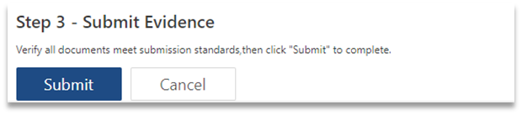
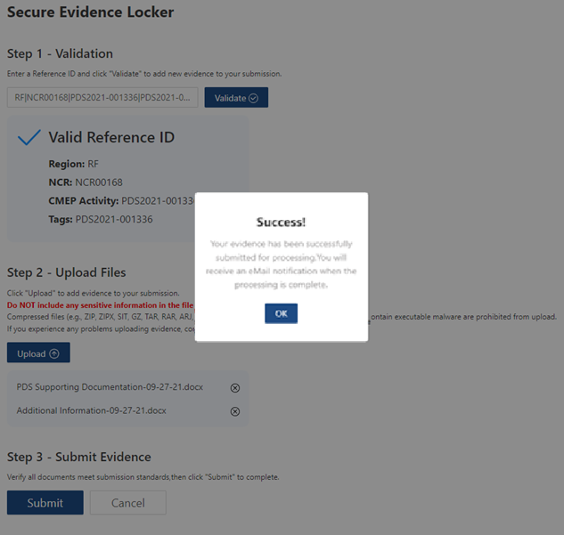

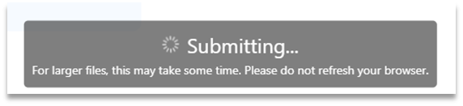
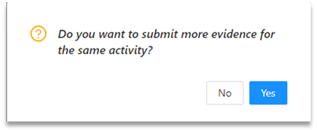
ERO Secure Evidence Locker Walkthrough

Slide 23

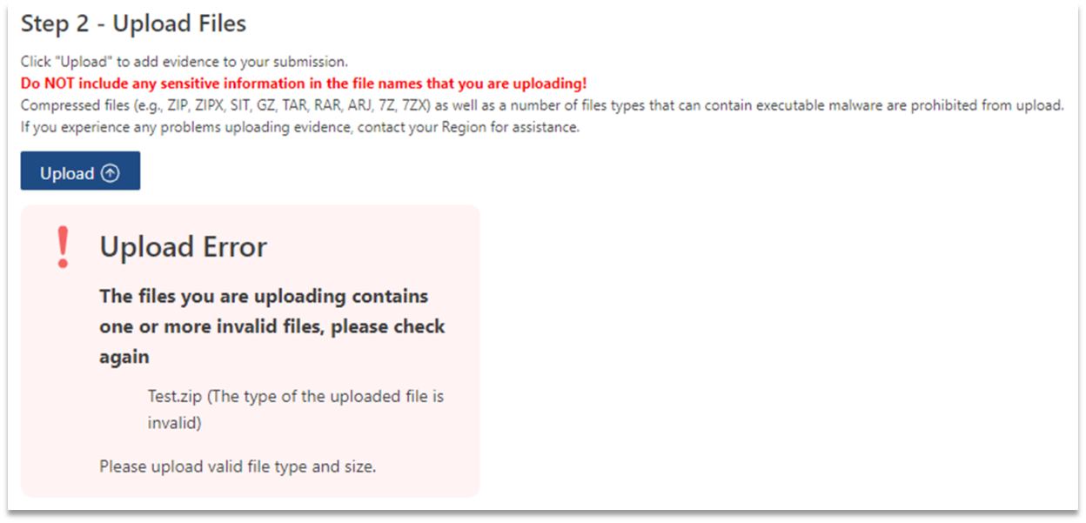
ERO Secure Evidence Locker Walkthrough

Slide 24

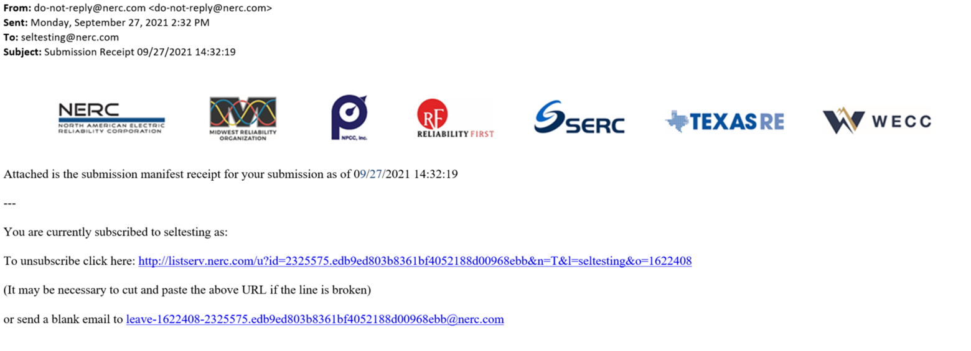
ERO Secure Evidence Locker Walkthrough

Slide 25



ERO Secure Evidence Locker Walkthrough

Slide 26
NERC Help desk tickets

Slide 27
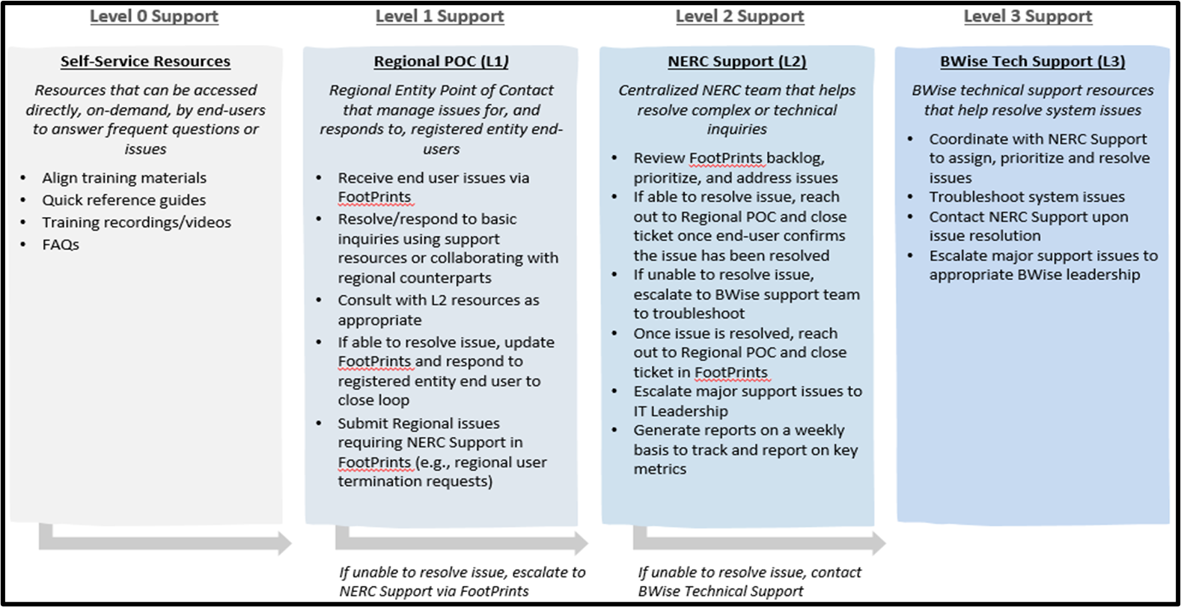
Align and ERO SEL Help Desk Support Model
Submit tickets to: https://support.nerc.net/ or through the ERO Portal

Slide 28
Align IRA Process

Slide 29
IRA Process
Align
  New and existing entities
    RF initiates the IRA process
    Entity is sent the Risk Factor Questionnaire (RFQ)/Entity Risk Profile Questionnaire (ERPQ) in Align to complete
    PCC, or who they assign, completes the questions in the RFQ/ERPQ questionnaires
    No quarterly or annual reviews/updates (at this time)

Slide 30
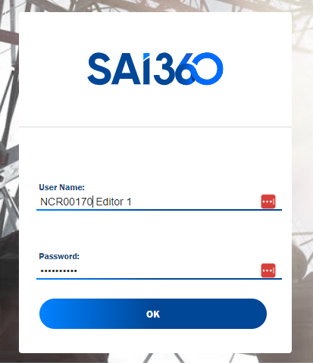
IRA Process
Entity logs into Align

Slide 31
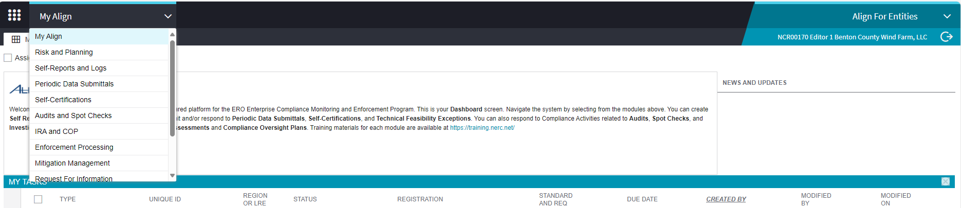
IRA Process
Select IRA and COP from My Align dropdown

Slide 32
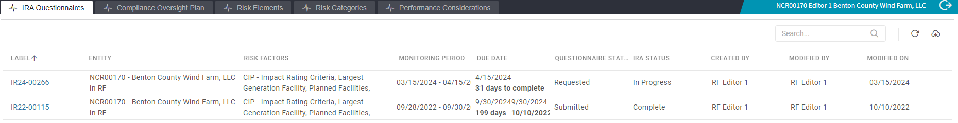


IRA Process
Select the Unique ID under the “Label” column for the requested IRA Questionnaire

Slide 33
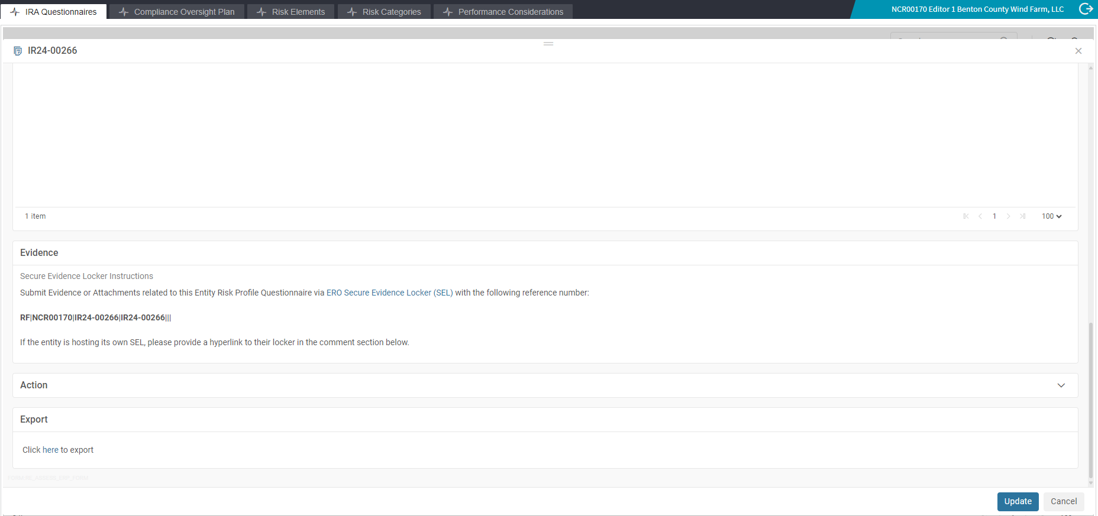



IRA Process
Optional, Entity can scroll down to bottom of screen and export the RFQ and ERPQ questions into a Word document and distribute to proper SMEs (to collect responses to questions prior to entry into Align).

Slide 34
IRA Process
There are two options for assigning an individual* to respond to the RFQ and ERPQ questions.
  Option 1 - You can assign yourself (this is the recommended approach) - Slide 36
  Option 2 - Assign a different individual - slides 37 through 40. Please note, if you use this option, you may end up with sets of questions (assigned to two different individuals) with no way of deleting one of the duplicate questions. This may cause issues.
*Note – only assign one individual per RFQ/ERPQ

Slide 35
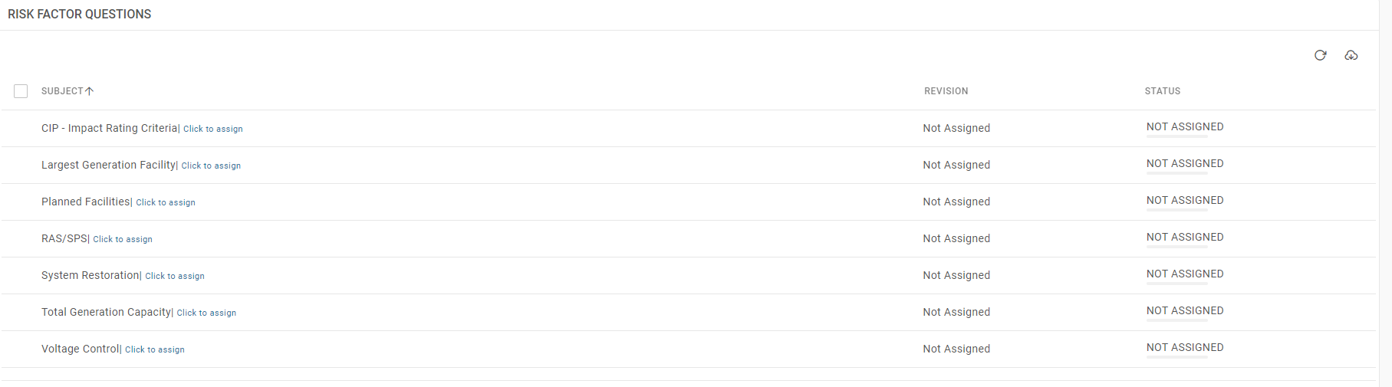
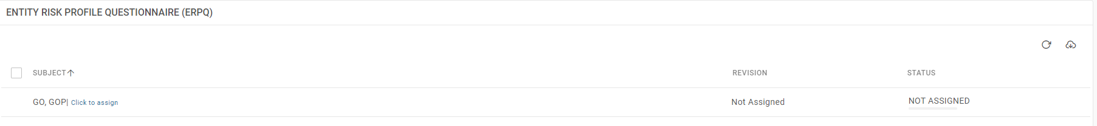





IRA Process
Assign each ‘Risk Factor Questions (RFQ)’ and ‘Entity Risk Profile Questionnaire (ERPQ)’.
Select “Click to assign” for each RFQ and ERPQ under the ‘Subject’ heading.

Slide 36
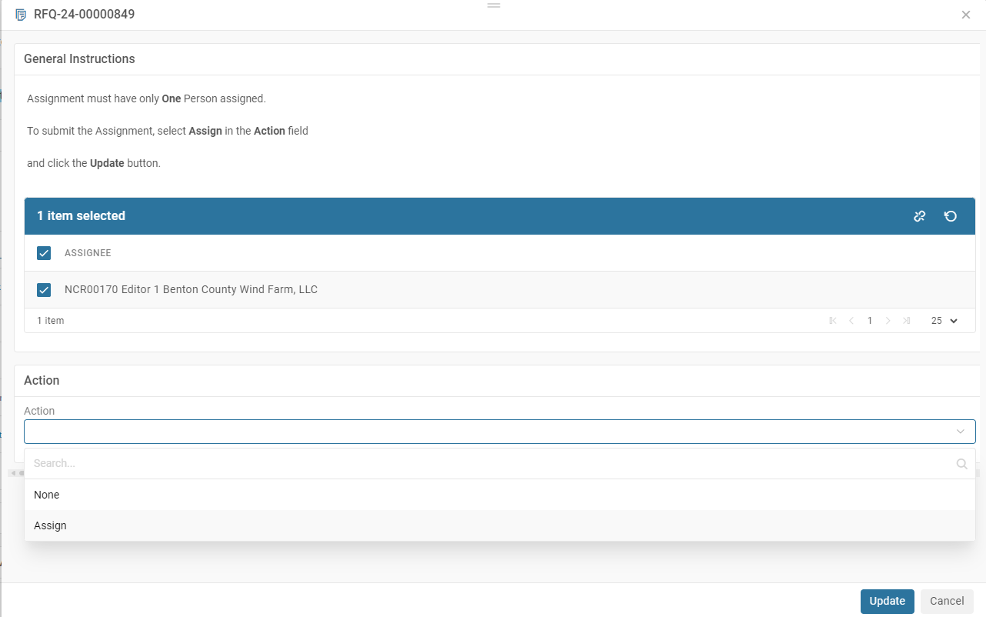



IRA Process (Option 1)
(Recommended Approach) To assign yourself, Select ‘Assignee’, select ‘Assign’ on the ‘Action’ dropdown and select ‘Update’

Slide 37
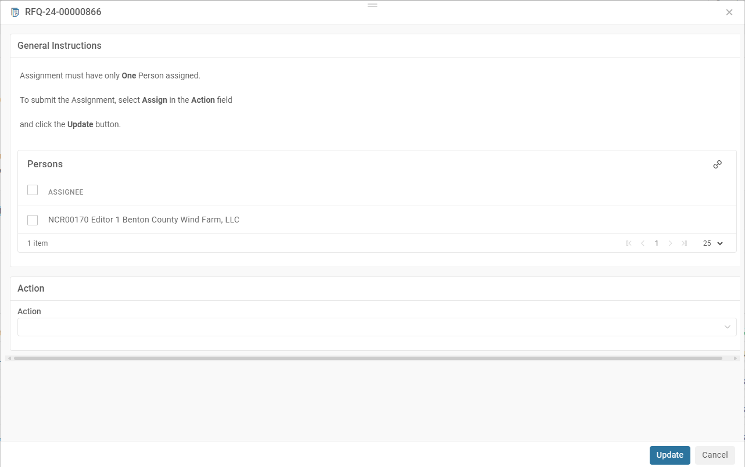
IRA Process (Option 2)
To assign a different individual, click the paper clip on the right side of the ‘Persons’ box.
Paper Clip

Slide 38
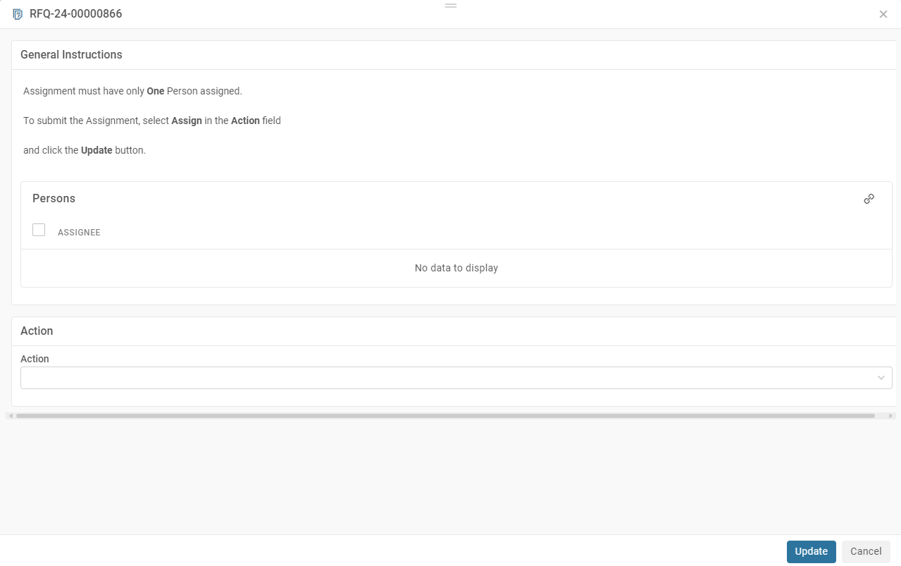
IRA Process (option 2)
Click the paper clip on the right side of the ‘Persons’ box.
Paper Clip

Slide 39
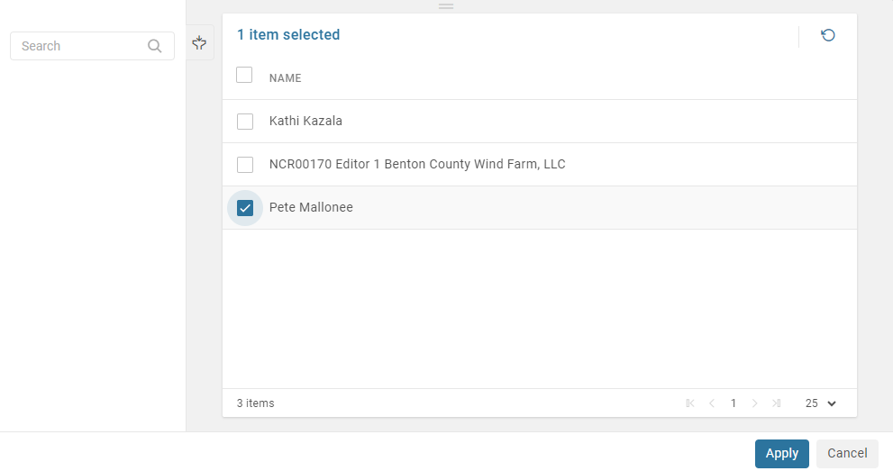

IRA Process (option 2)
Select the individual you want to assign to the RFQ or ERPQ, then click ‘Apply’. Only assign one individual per RFQ and ERPQ.

Slide 40
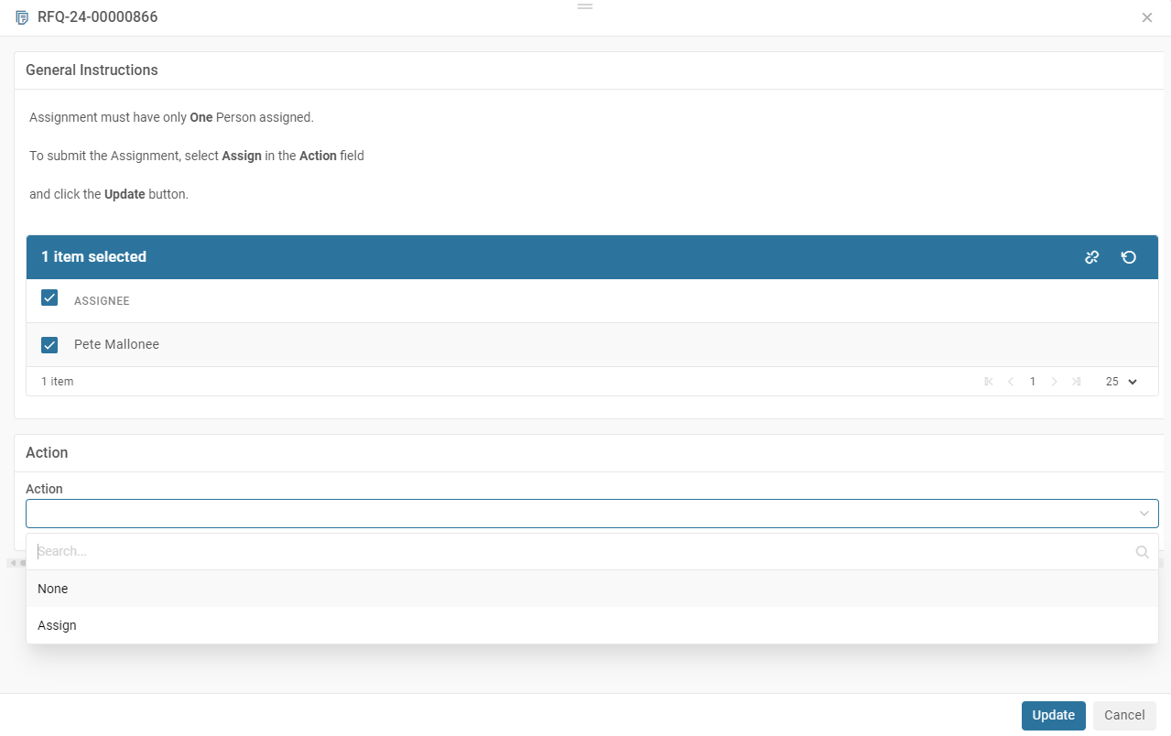






IRA Process (option 2)
Select Assignee, Action ‘Assign’, then click ‘Update’ to complete assignment. Complete these steps for each RFQ and ERPQ.

Slide 41
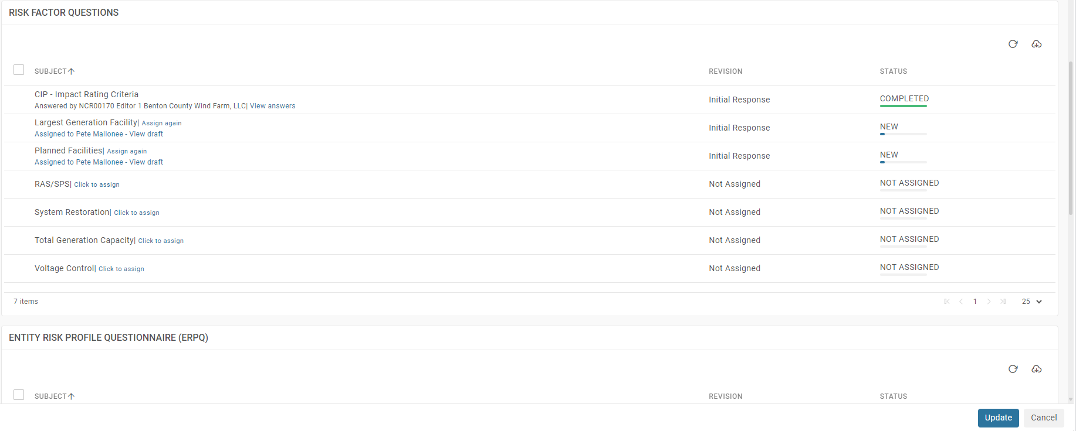


IRA Process (option 2)
The selected Assignee will appear in the Assigned to for each RFQ and ERPQ.

Slide 42



IRA Process
Secure Evidence Locker

Slide 43
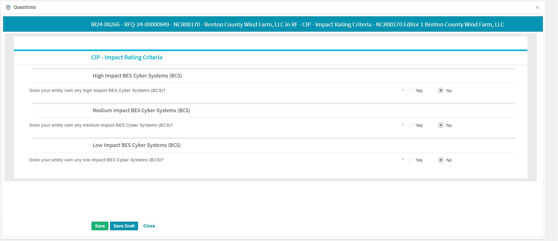

IRA Process
Complete all questions for RFQ and ERPQ, click ‘Save Draft’ or ‘Save’ to save responses (see note below).
Note: Save Draft – Saves Draft saves responses and allows responses to be changed.
Save – Saves responses and cannot be changes.

Slide 44
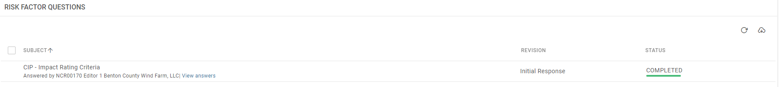
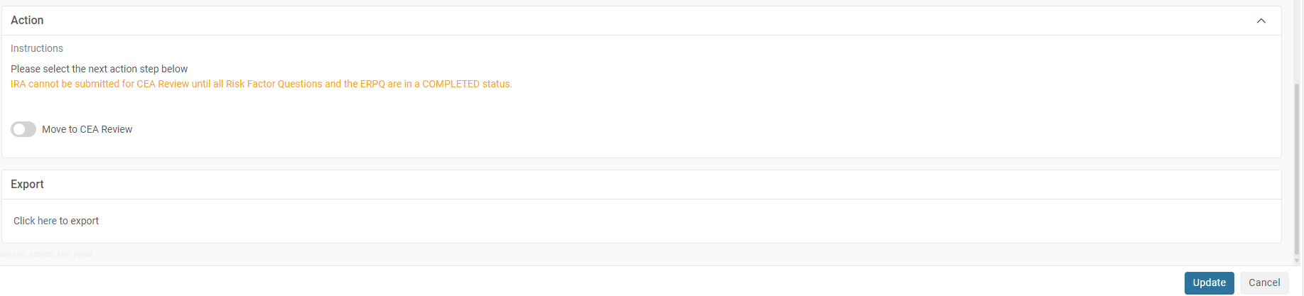




IRA Process
Once all questions are completed for RFQ and ERPQ, Under Action, toggle switch to ‘Move to CEA Review’, and click ‘Update’

Slide 45
Training resources

Slide 46
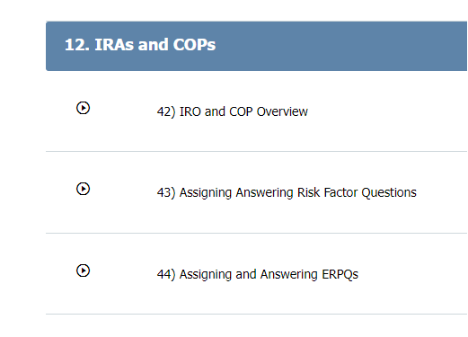
Training Resources
Links related to Align and SEL Training - https://training.nerc.net/
  Release 4.5 User Guide - IRAs and COPs
  User Access Guide
  SEL Portal User Guide
  Support Process
  Video Training

Slide 47

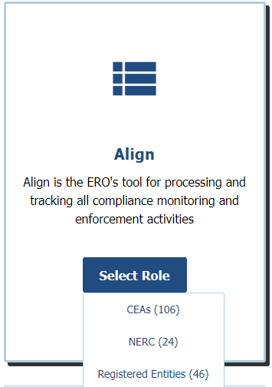
Training Resources
Links related to Align and SEL Training – https://training.nerc.net/

Slide 48

Training Resources
Links related to Align and SEL Training – https://training.nerc.net/
Note: Section 12. IRAs and COPs (3 videos)

Slide 49
Anthony Jablonski
Bob Folt
Frank Kapuscinski
Dirk Baker

