Slide 1
Base Load vs Solar + Battery
February 2024

Slide 2
Base load compared to hybrid
100 MW Base Load Generation
300 MW Solar + 400 MW Batteries
100 MW Traditional Base Load generates 2400 MWh
Assume 8 hours of sunlight
Assume no losses in conversion
Usage
100 MW solar for 8 hours (800 MWh)
400 MW storage for 4 hour discharge (1600 MWh)
Storage
200 MW solar to charge storage 8 hours (1600 MWh)
B
S
B
T
B
B
S
S

Slide 3
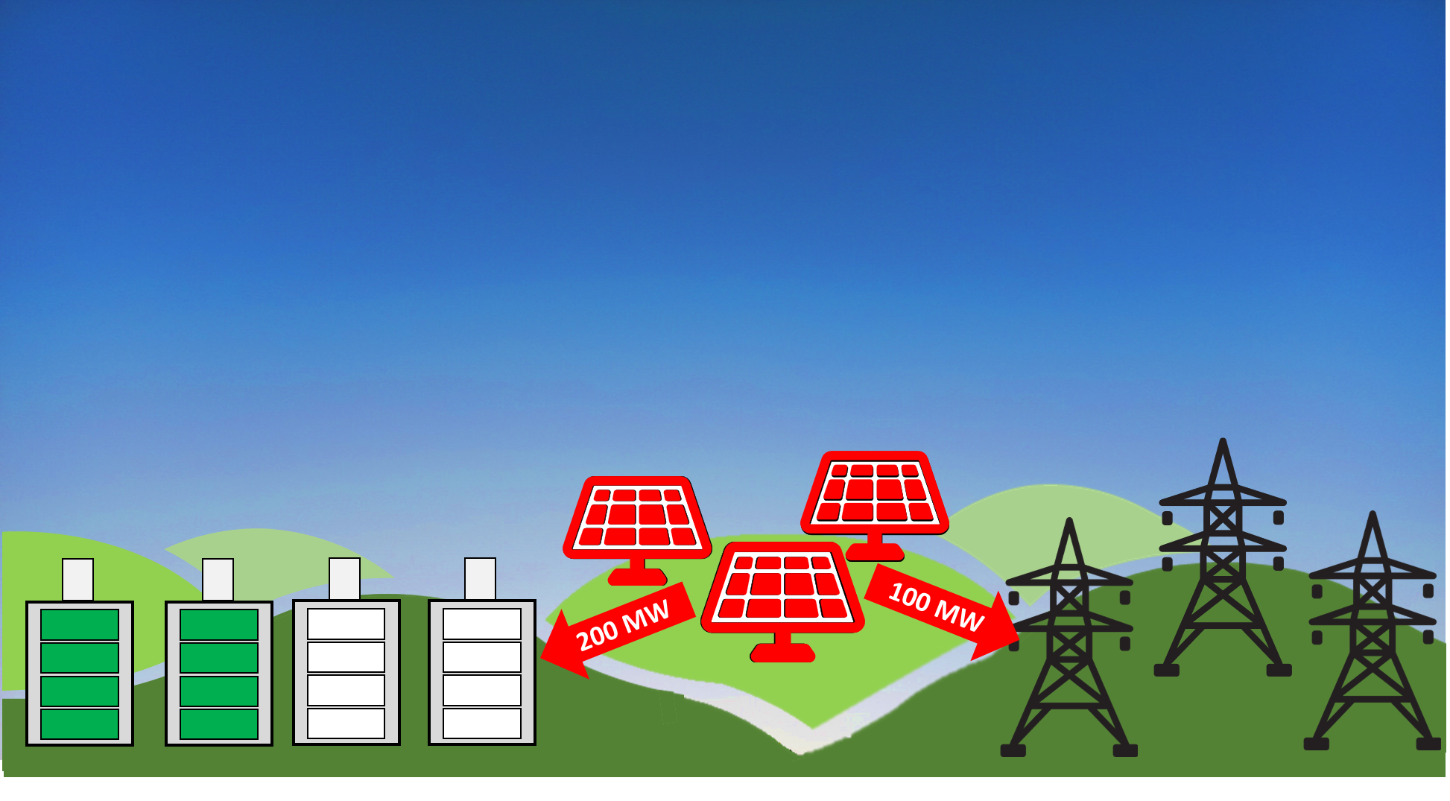
12:00
07:00
12:00
03:00
01:00
08:00
09:00
10:00
11:00
04:00
04:00
02:00
02:00
07:00
01:00
11:00
05:00
08:00
06:00
05:00
10:00
12:00
12:00
09:00
06:00
03:00
100 MW
200 MW
100 MW

